Slide 1

WP4.3
Rafael Segundo and Luigi Vanfretti – KTH
June 25th, 2013, Nice, France

Slide 2
Introduction
In this presentation it is shown part of the validation of the different indices. Illustrative examples using real data provided by WP4.3 partners are presented.
Organization of the presentation:
Information received
Under/over voltage
Case studies
Overloads
Case studies
Transient Stability
Case studies
Future work

Slide 3
Signal Classification
It is necessary to classify each of the signals into different parts before to be analyzed:
Pre-contingency
Post-contingency
Pre-contingency: period of time where the signal is in nominal conditions (no disturbance).
Nonlinear
behavior
Post-contingency: Period of time just after any disturbance in the system.
Nonlinear behavior: Short period of time, few seconds, after a disturbance.
Window to be analyzed: Small window of time before the end of the simulation and after any contingency and the nonlinear behavior.
Window to be analyzed

Slide 4
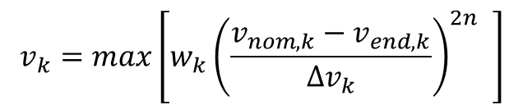
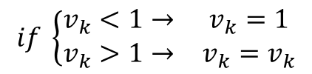
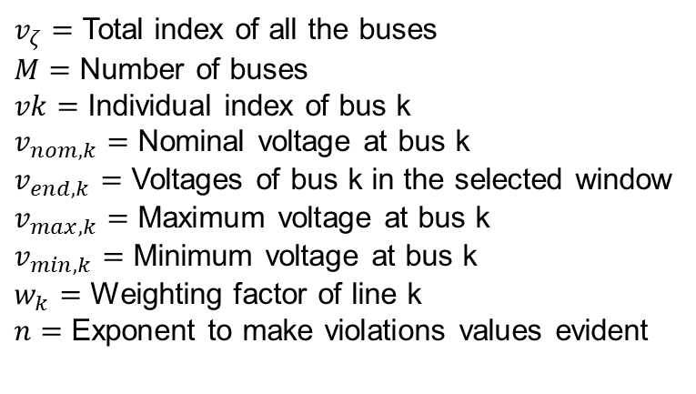
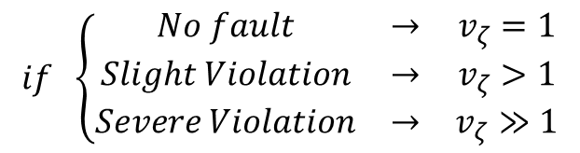
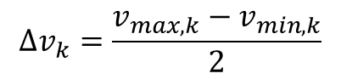
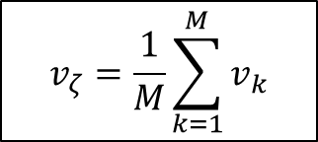
Post-fault under/over voltage
Useful to observer whether the deviation of voltages surpass those acceptable in the operational standards. Monitoring the voltage across the transmission network right after an outage occurs.
$v_{ζ}=$ Total index of all the buses
$M=$ Number of buses
$vk=$ Individual index of bus k
$v_{nom,k}=$ Nominal voltage at bus k
$v_{end,k}=$ Voltages of bus k in the selected window
$v_{max,k}=$ Maximum voltage at bus k
$v_{min,k}=$ Minimum voltage at bus k
$w_{k}=$ Weighting factor of line k
$n=$ Exponent to make violations values evident
$$v_{ζ}=\frac{1}{M}\sum_{k=1}^{M}{v_{k}}$$
$$v_{k}=max\left[w_{k}{\left(\frac{v_{nom,k}−v_{end,k}}{{∆v}_{k}}\right)}^{2n} \right]$$
$${Δv}_{k}=\frac{v_{max,k}−v_{min,k}}{2}$$
Index Classification
Considerations
$$if \left\{\begin{matrix}No fault & → & v_{ζ}=1 \\ Slight Violation & → & v_{ζ}>1 \\ Severe Violation & → & v_{ζ}≫1\end{matrix}\right.$$
$$if \left\{\begin{matrix}v_{k}<1→ & v_{k}=1 \\ v_{k}>1→ & v_{k}=v_{k}\end{matrix}\right.$$

Slide 5
Under/over Voltage: Case study 1
Case study: 6799 buses, disturbance at 2sec, simulation length 20 sec .
Analyzed window

Slide 6





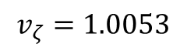
$$v_{ζ}=1.0053$$
$$v_{nom,4}$$
$$v_{max,4}$$
$$v_{end,4}$$
Only 5 buses with slight violation of the limits
$$v_{min,4}$$
Note that this index is based on the maximum point of the analyzed window, another option is to consider the average value
$$Violation$$

Slide 7
Under/over Voltage: Case study 2
Case study: 6799 buses, severe disturbance at 62 sec.

Slide 8
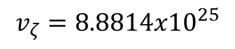
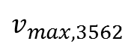

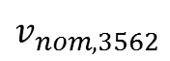

$$v_{max,3562}$$
$$v_{ζ}=8.8814{x10}^{25}$$
$$v_{min,3562}$$
$$v_{nom,3562}$$
15975 buses violating the limits
$$v_{end,3562}$$
$$Violation$$

Slide 9
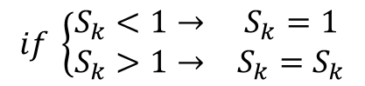
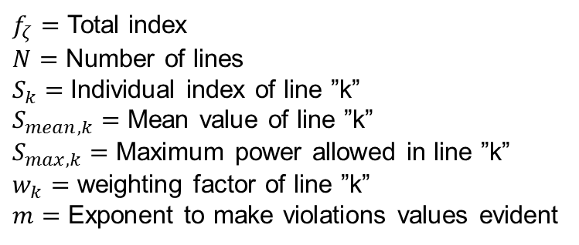
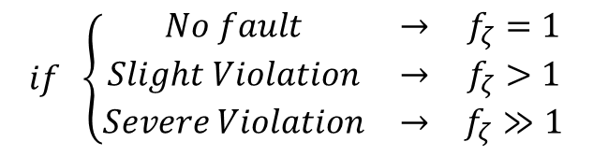
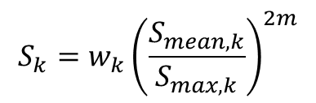
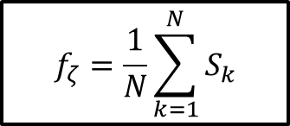
Post-fault overloads
Useful to observer if the post-fault flows surpass the network capacity. Monitoring the power flows through the transmission lines right after an outage occurs.
$$f_{ζ}=\frac{1}{N}\sum_{k=1}^{N}{S_{k}}$$
$f_{ζ}=$ Total index
$N=$ Number of lines
$S_{k}=$Individual index of line ”k”
$S_{mean,k}=$ Mean value of line ”k”
$S_{max,k}=$ Maximum power allowed in line ”k”
$w_{k}=$ weighting factor of line ”k”
$m=$ Exponent to make violations values evident
$${S_{k}=w}_{k}{\left(\frac{S_{mean,k}}{S_{max,k}}\right)}^{2m}$$
Index Classification
Considerations
$$if \left\{\begin{matrix}No fault & → & f_{ζ}=1 \\ Slight Violation & → & f_{ζ}>1 \\ Severe Violation & → & f_{ζ}≫1\end{matrix}\right.$$
$$if \left\{\begin{matrix}S_{k}<1→ & S_{k}=1 \\ S_{k}>1→ & S_{k}=S_{k}\end{matrix}\right.$$

Slide 10
Overloads: Case study 1
Case study: 898 lines, disturbance at 2sec, simulation length 20 sec .
Analyzed window

Slide 11
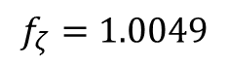
Criteria: Smean should not exceed more than 10%, the nominal value
Lines violating Smax value
$$f_{ζ}=1.0049$$
7.28%
Only 3 lines with slight violation of the limits
3.84%
0.8%
Smean=6.72
Smax=6.26
Snom=5.69
Note that this index is based on the average value

Slide 12
Under/over Voltage: Case study 2
Case study: 118 lines, sever disturbance at 10 sec, simulation length of 15 sec.
Analyzed window

Slide 13
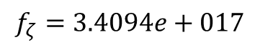
Criteria: Smean should not exceed more than 10%, the nominal value
$$f_{ζ}=3.4094e+017$$
43 lines violating the limits
Smean=195.5
Snom=19.3
Smax=21.26

Slide 14
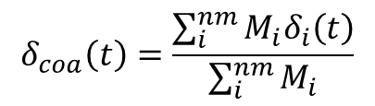
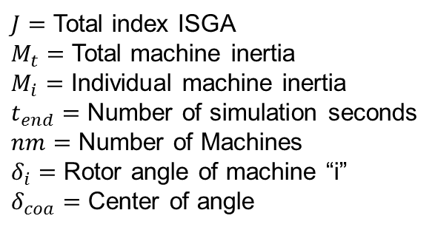
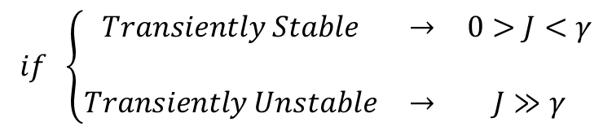

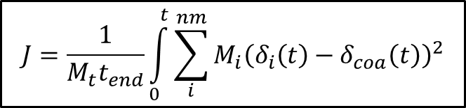
Transient stability
Multimachine integral square generator angle index (ISGA).
$$J=\frac{1}{M_{t}t_{end}}\int_{0}^{t}{\sum_{i}^{nm}{M_{i}{\left(δ_{i}\left(t\right)−δ_{coa}\left(t\right)\right)}^{2}}}$$
$J=$ Total index ISGA
$M_{t}=$ Total machine inertia
$M_{i}=$ Individual machine inertia
$t_{end}=$ Number of simulation seconds
$nm=$ Number of Machines
$δ_{i}=$ Rotor angle of machine “i”
$δ_{coa}=$ Center of angle
$$δ_{coa}\left(t\right)=\frac{\sum_{i}^{nm}{M_{i}δ_{i}\left(t\right)}}{\sum_{i}^{nm}{M_{i}}}$$
Considerations
Index Classification
Disconnected generator are not included in the summation of Mt
$$if \left\{\begin{matrix}Transiently Stable & → & 0>J<γ \\ & & \\ Transiently Unstable & → & J≫γ\end{matrix}\right.$$
$γ→$Value that depend of different factors such as: number of machines, inertia of the machines.

Slide 15
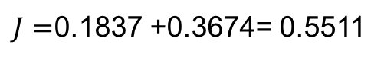
Illustrative example
Two machines:
Inertia of Machie 2 is two times the Inertia of Machie 1
$J=$0.1837 +0.3674= 0.5511
The total index is the integral of the distance from each machine to the center of inertia or angle.

Slide 16
Transient Stability: case study 1
Case study: 772 machines, different disturbances at 2, 22, 42 and 62 sec, total simulation length of 82 sec.
Analyzing TS after disturbance at 2 sec

Slide 17
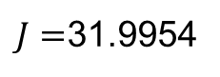
$J=$31.9954
No transient stability
Note that might be required to normalize this index

Slide 18
Transient Stability: case study 2
Case study: 772 machines, disturbances at 2, 22, 42 and 62 sec, total simulation length of 82 sec.
Analyzing TS after last disturbance at 62 sec

Slide 19
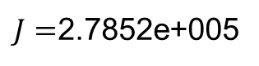
$J=$2.7852e+005
Severe transient stability problem

Slide 20
Conclusions
Over/under voltage index can be calculated based on the maximum violation point or in the average value.
Limits for voltage and overload has been considered as a given plus\minus percent.
Transient stability index might need to be normalized
More simulations to validate voltage stability index will be provided by RTE

